Slide 1
Arizona state symbols
By Aidan Eger and Jonthan martin

Slide 2
Bald egle
This symbole means freedom and equal rights to everyone.

Slide 3
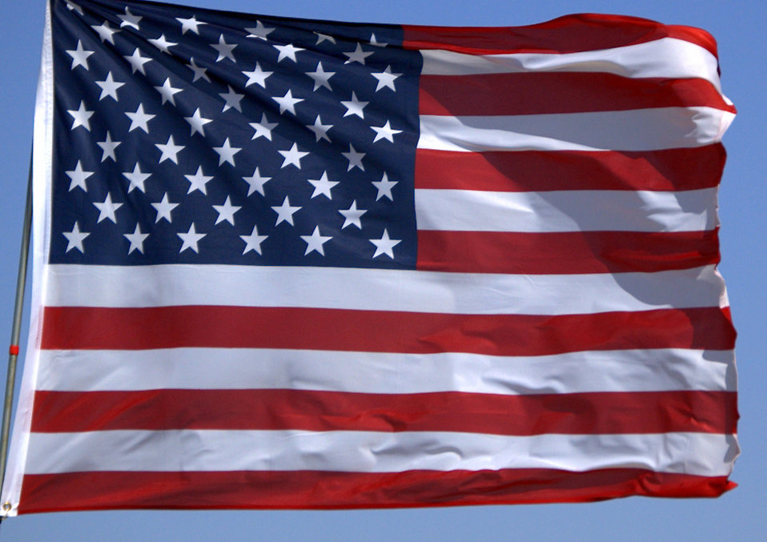
American flag
It means we are free and have plage wich is like this i plage alishins to the flag of the unidted states of america and to the public under god inivisable with liberty and justes for all.

Slide 4
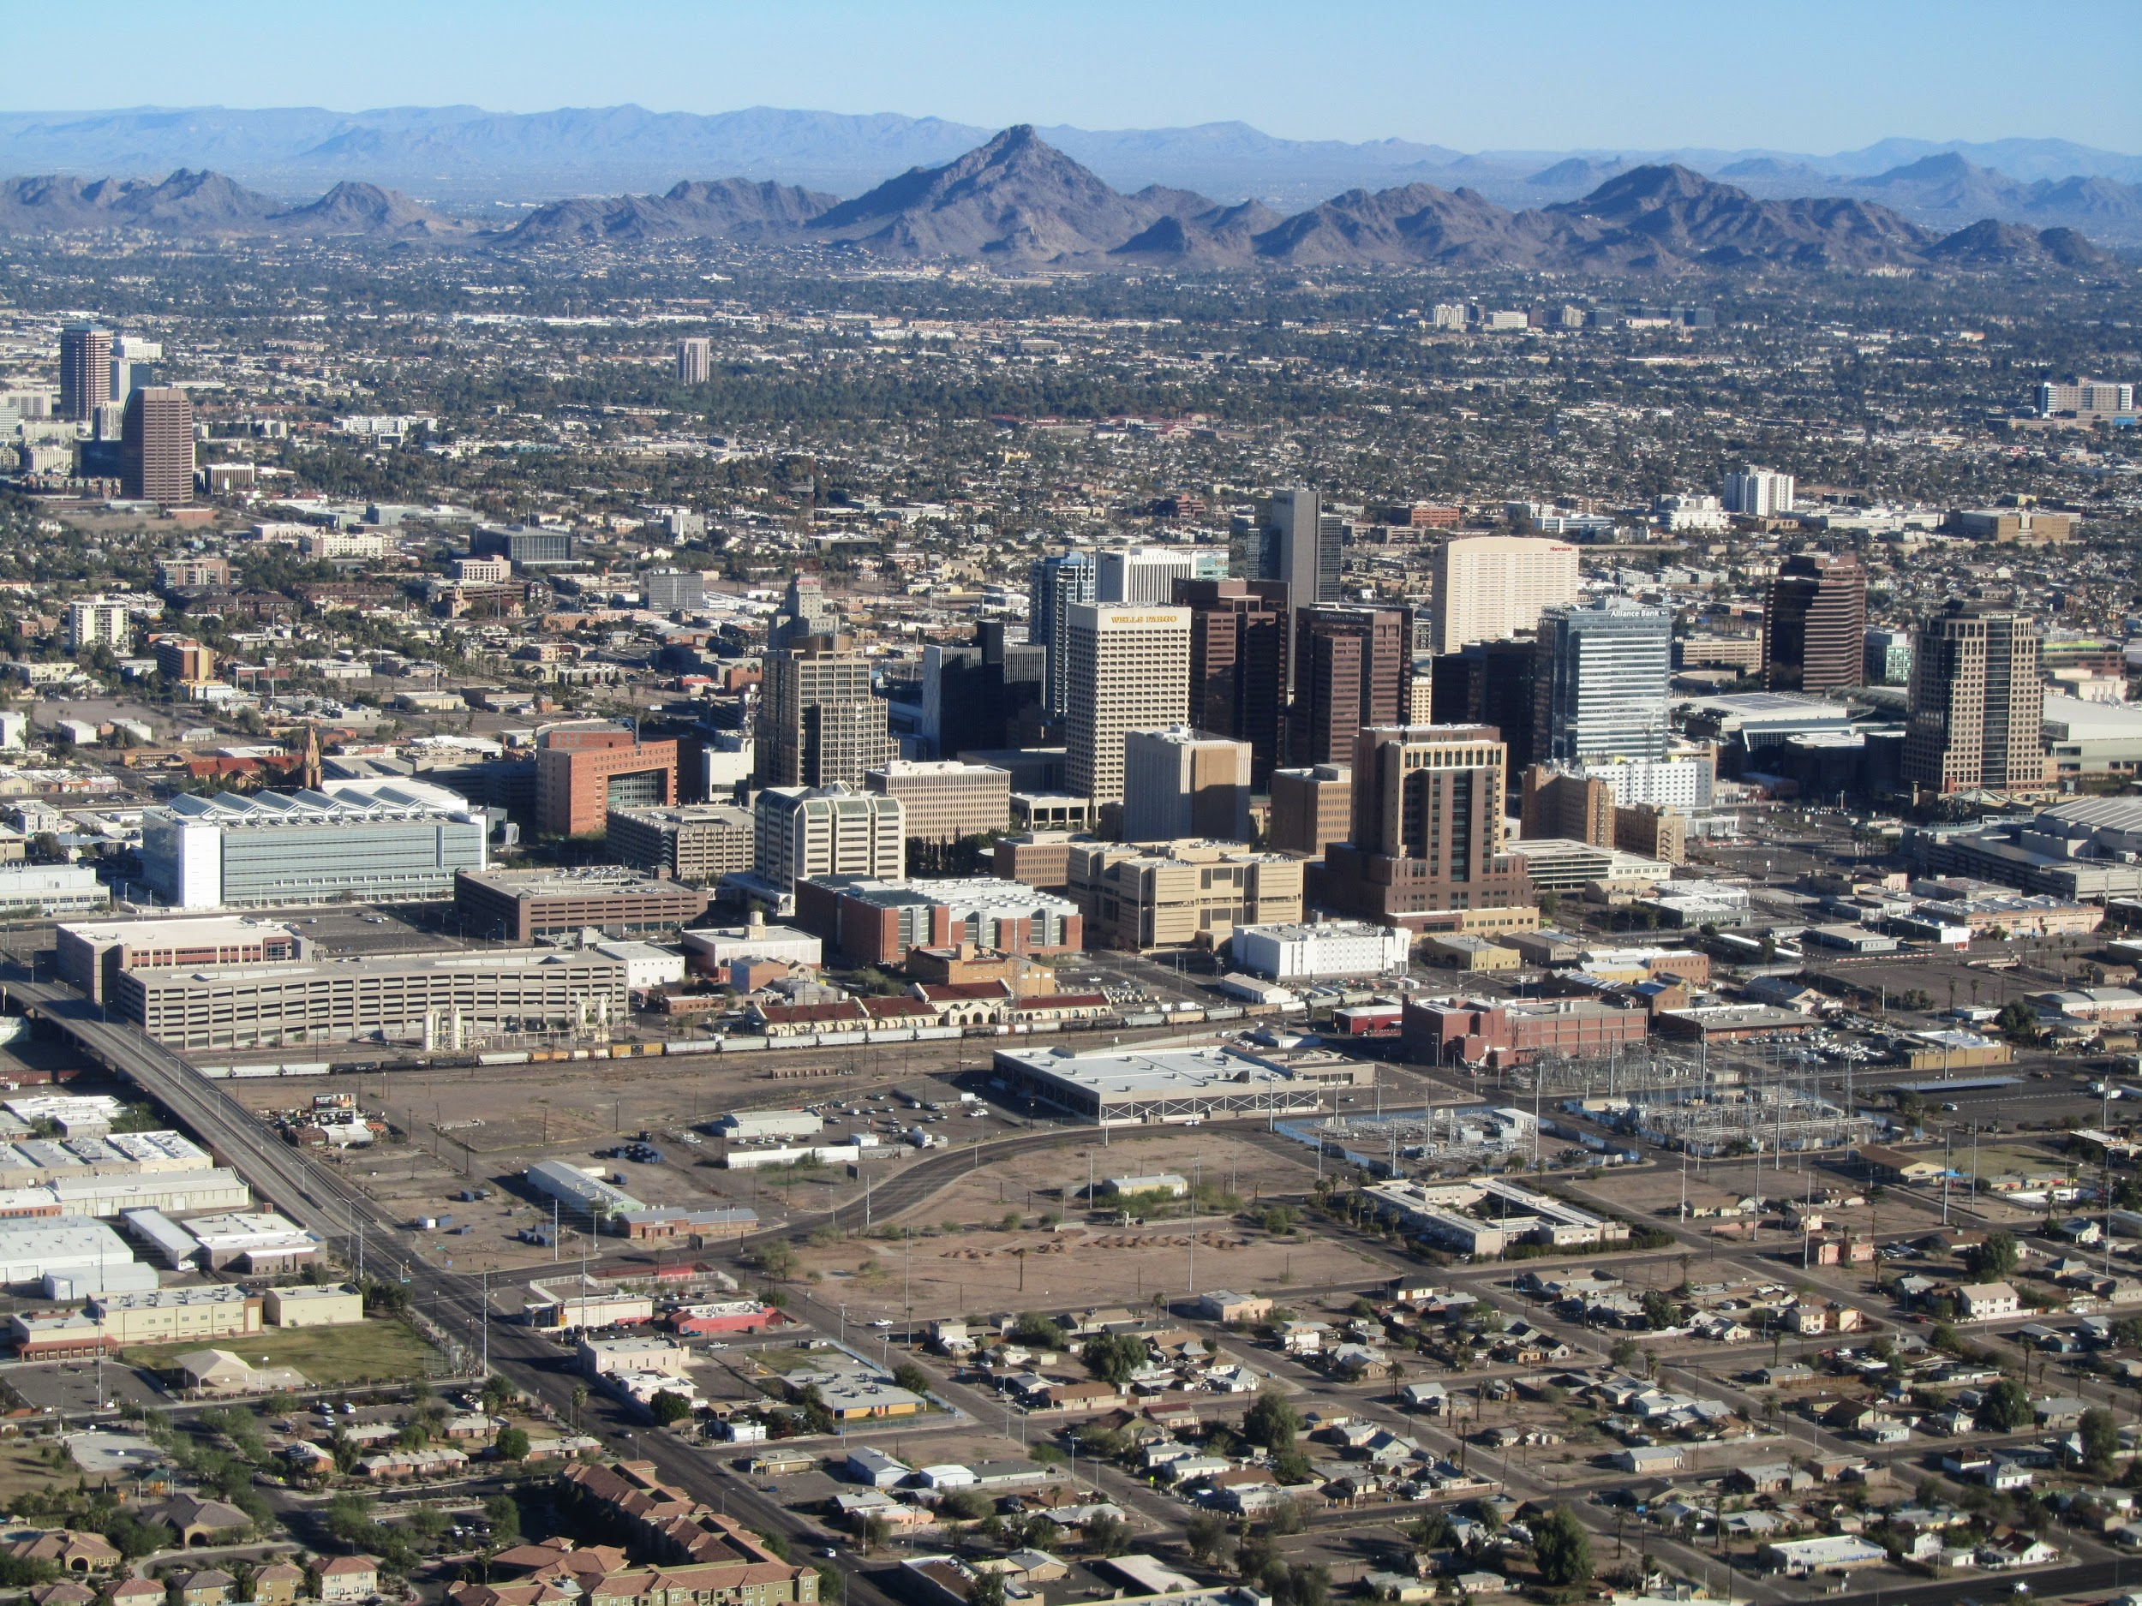
The capital of arizona
The capital of arizona is phoenix is a importent part of our. It move 7 times before i settled in phonix .(thats so suprising)

Slide 5
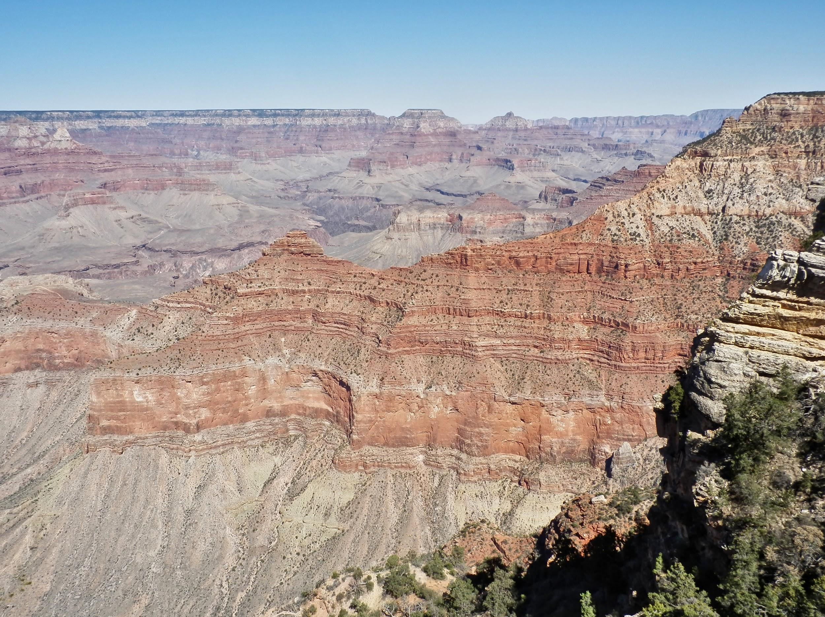
The grand canyon
The grand canyon is a very cool place and its the biggest canyon. (in Arizona)

