Slide 1
Arizona State Symbols
By: Makenzie Reishman & Bella Beeswy

Slide 2
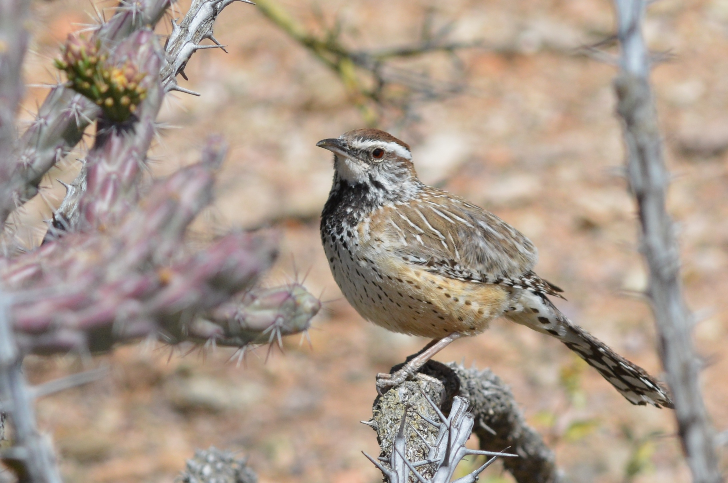
State Bird
The Arizona state bird is the Cactus Wren.

Slide 3
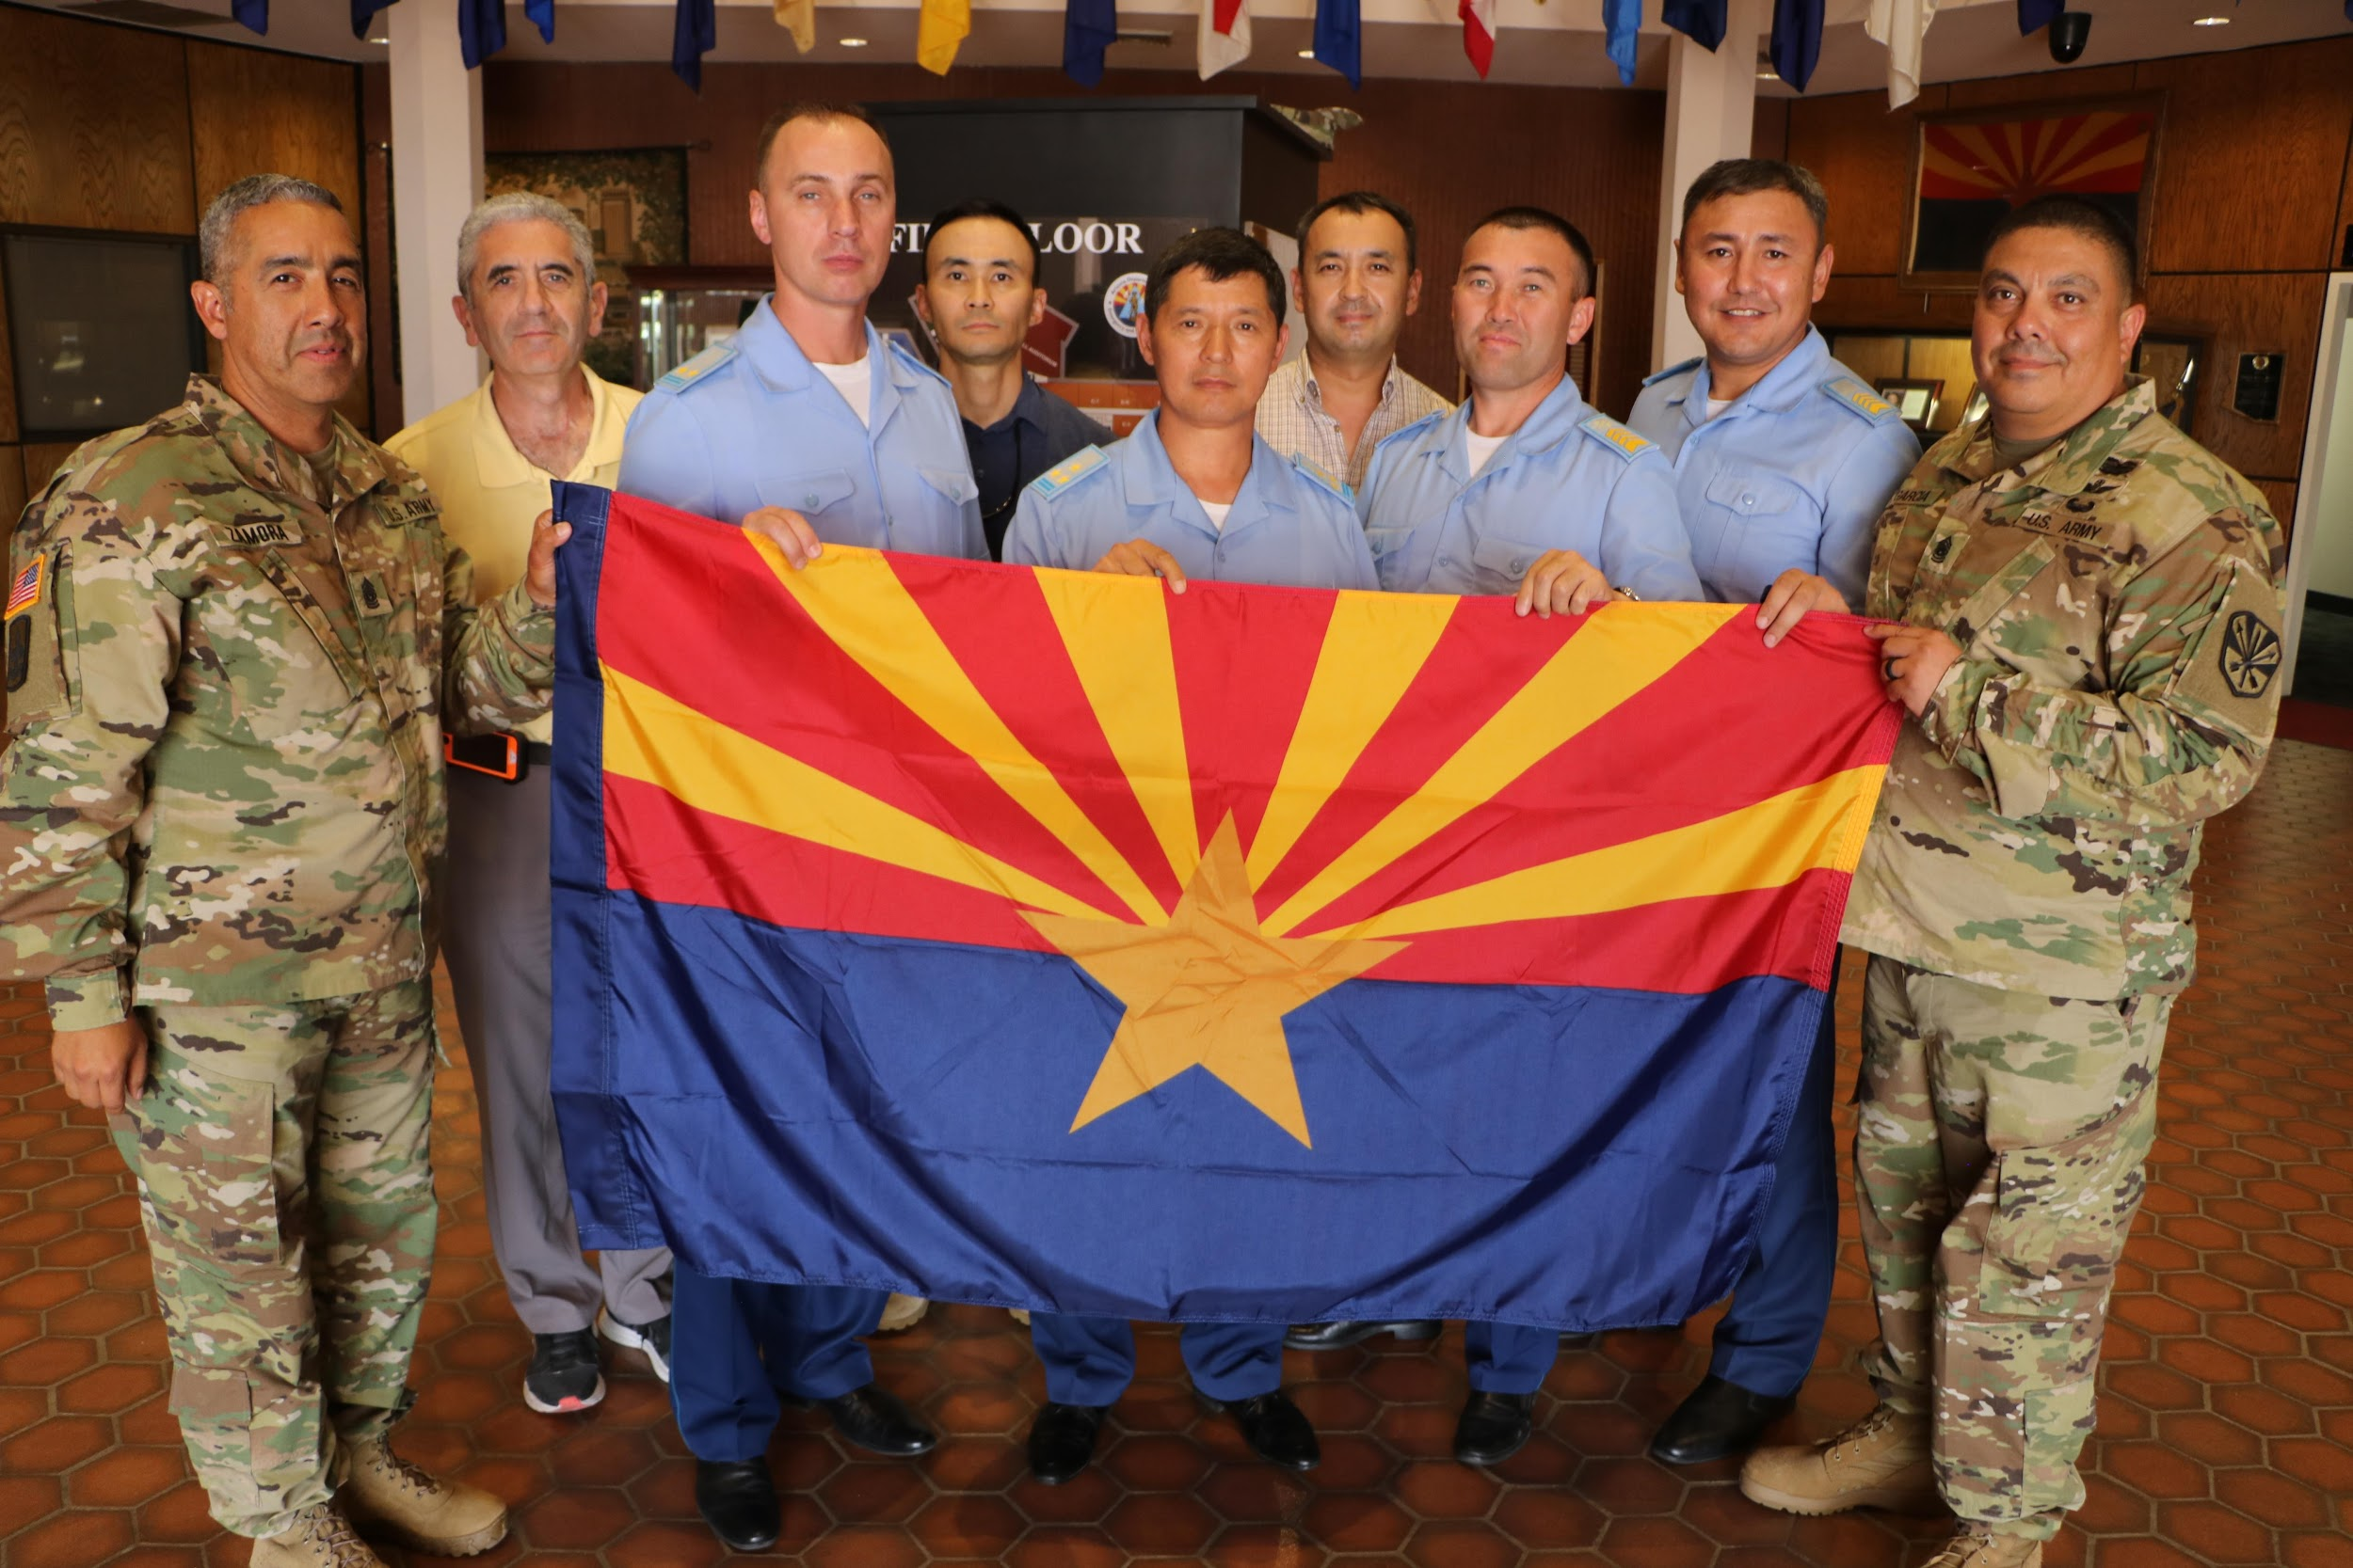
State Flag
The Arizona state flag looks like this...

Slide 4
State Seal
The sun and reservoir represent Arizona's dry and sunny climate. In the middle of the seal are irrigated fields and orchards to represent farming; and, in the lower right side we see ranching represented in the form of grazing cattle. To the left, on a mountainside, is a quartz mill with a miner with a pick and shovel.

Slide 5
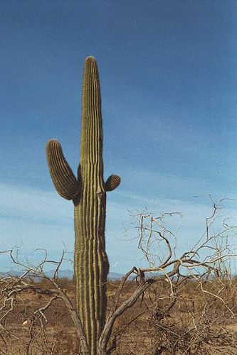
State Flower
The Arizona state flower is the Saguaro Cactus.

Slide 6
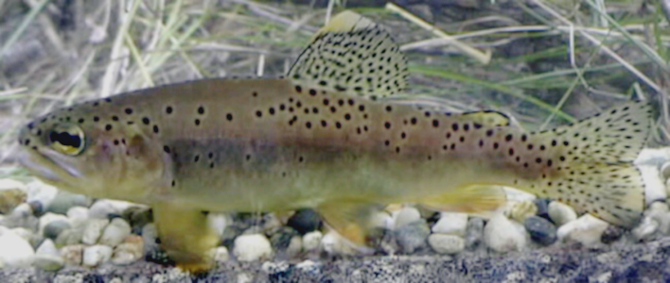
State Fish
The Arizona state fish is the Apache Trout.

Slide 7
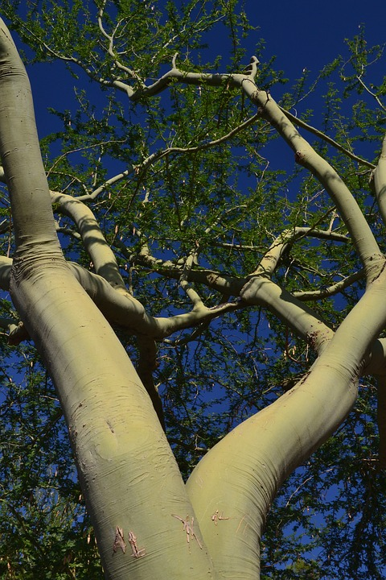
State Tree
The Arizona state tree is the Blue Palo Verde.

Slide 8
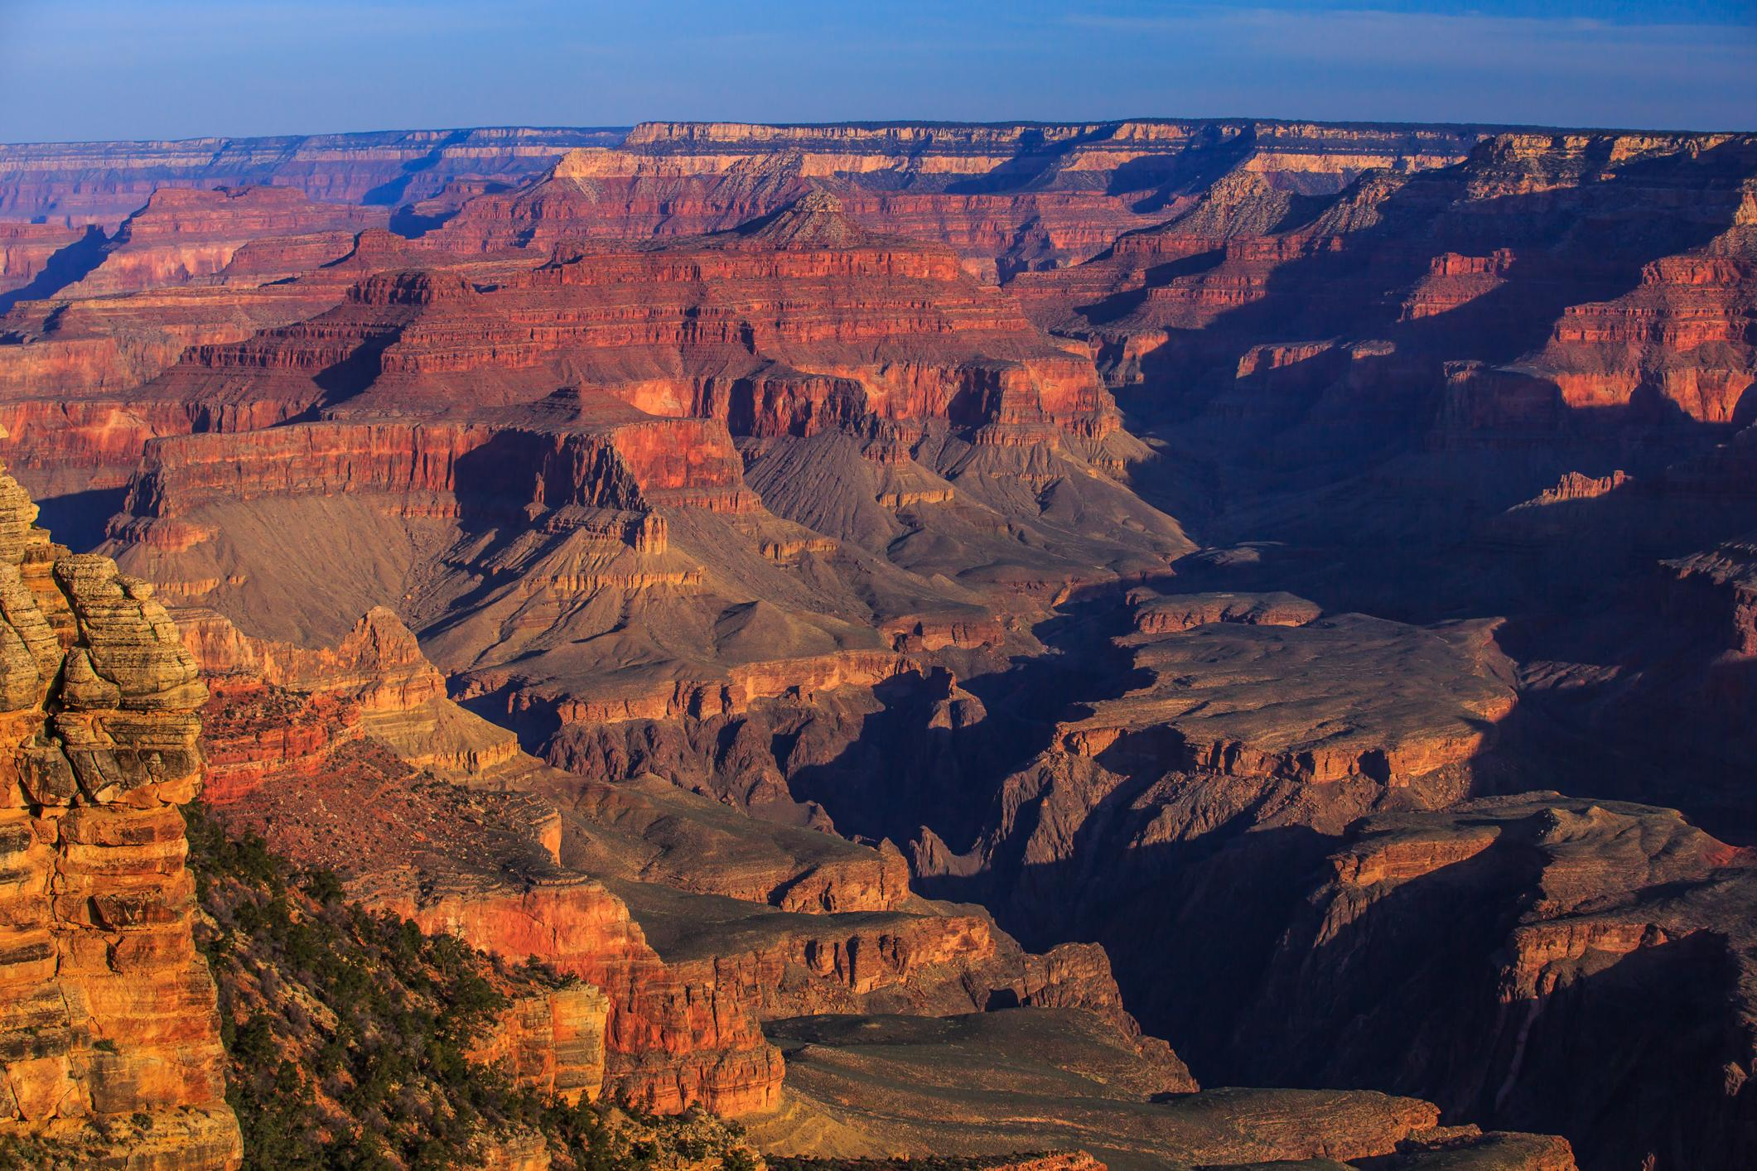
Nicknames
Some nicknames for Arizona is The Grand Canyon State and The Copper State.

Slide 9
The end
We hope you enjoyed our Arizona state symbols slideshow and we had a lot of fun making it.

