Slide 1
Arizona state symbols
By: Nathanael

Slide 2
One arizona symbol
Great seal of the state of arizona
1912 is the date that arizona became a state
Its birthday is february 14, 1912

Slide 3
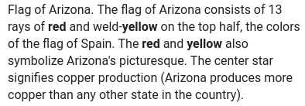
2nd symbol

Slide 4
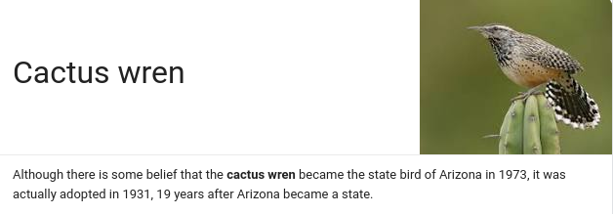
3rd symbol

Slide 5
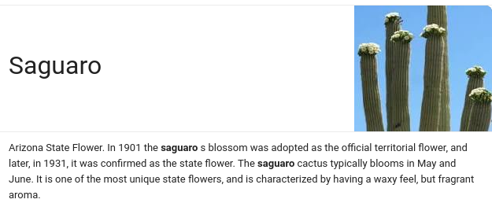
4th symbol

Slide 6
5th symbol

Slide 7
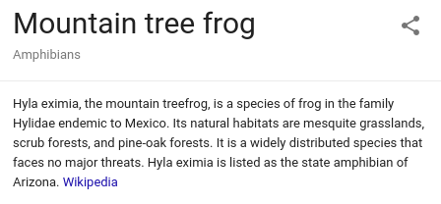
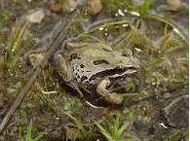
6th symbol

