Slide 1
Arizona Symbols
By: Jax and Brenna

Slide 2
Arizona State March Song
Come to this land of sunshine
To this land where life is young.
Where the wide, wide world is waiting,
The songs that will now be sung.
Where the golden sun is flaming
Into warm, white, shining day,
And the sons of men are blazing

Slide 3
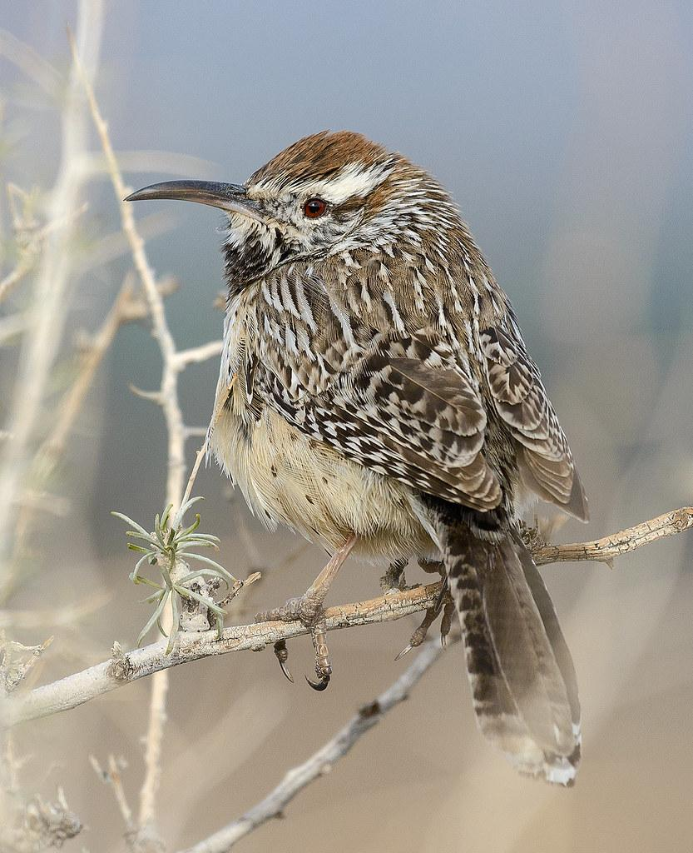
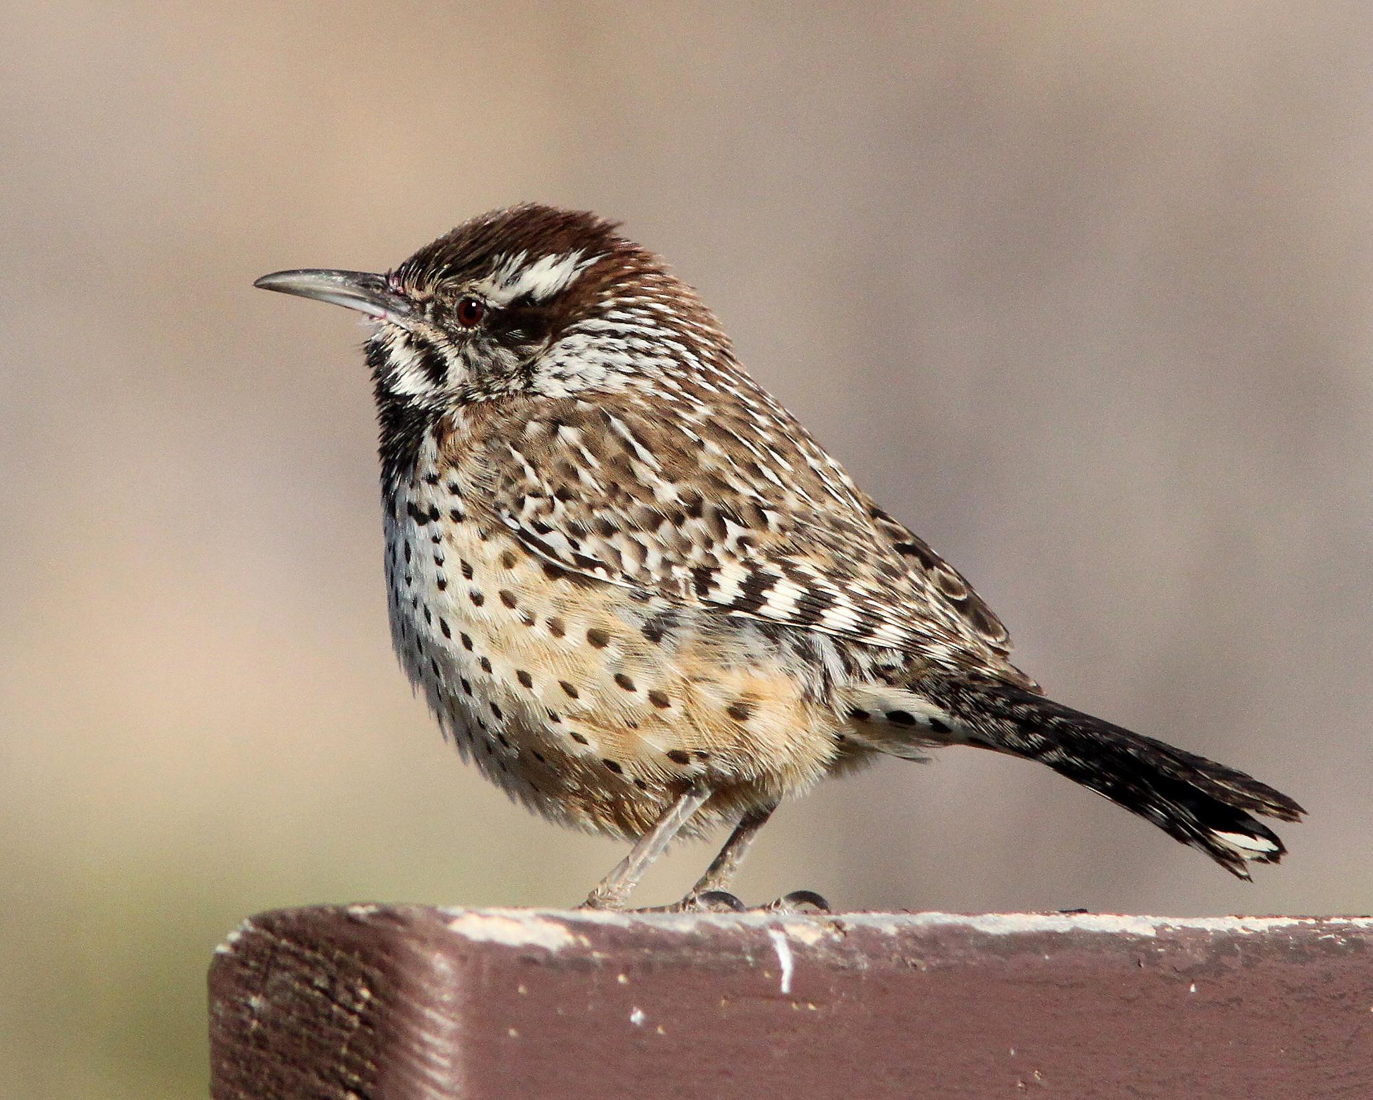
State bird: Cactus Wren

Slide 4
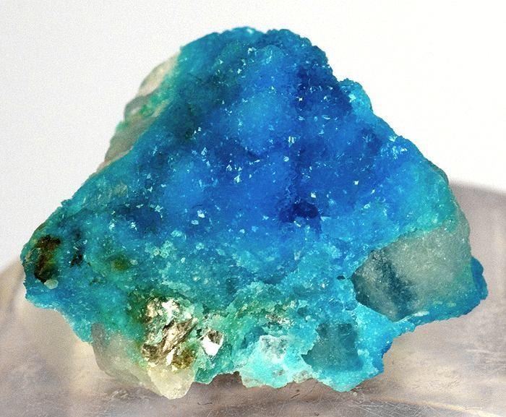
State gem: Turquoise

Slide 5
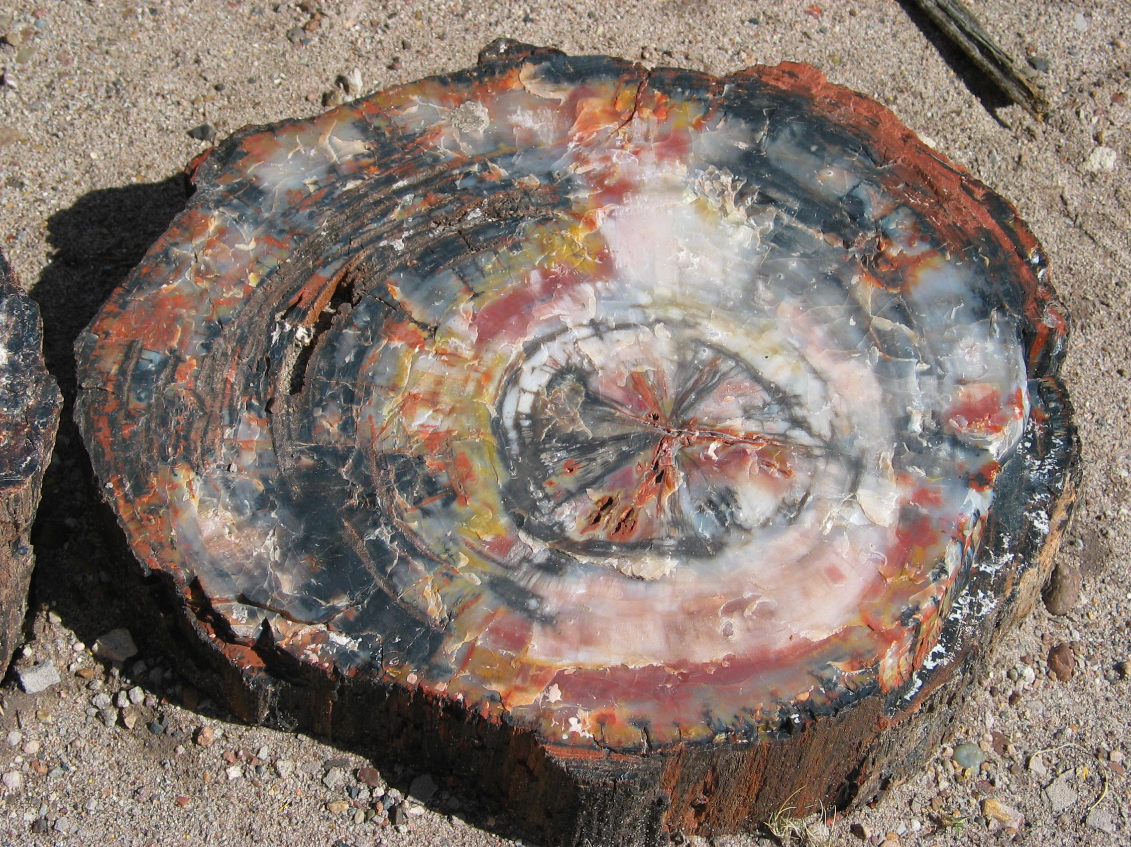
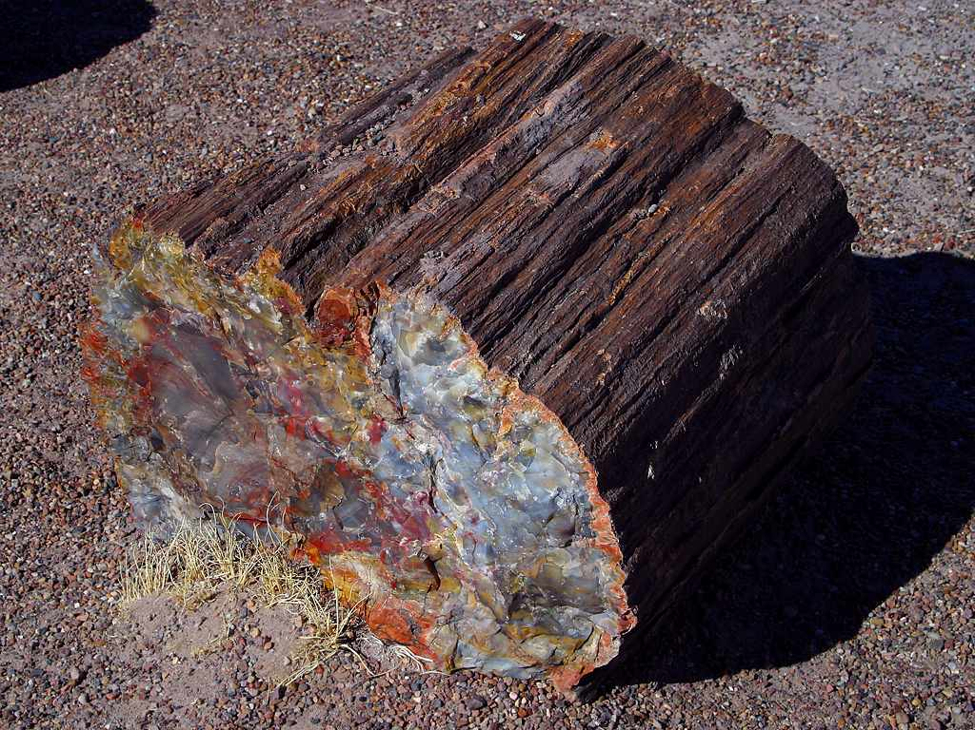
State Fossil: Petrified Wood

Slide 6
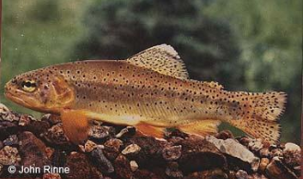
State fish: Apache trout

Slide 7
State colors: Gold and blue

Slide 8
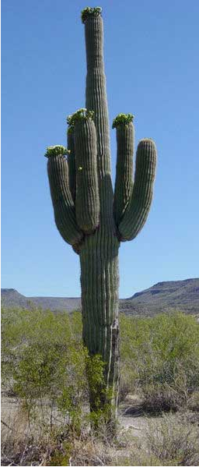
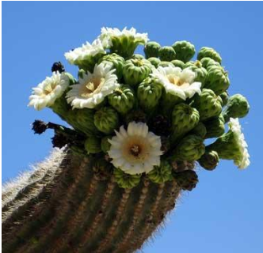
Saguaro Cactus Blossom

Slide 9
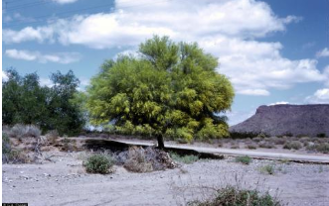
Palo verde

Slide 10
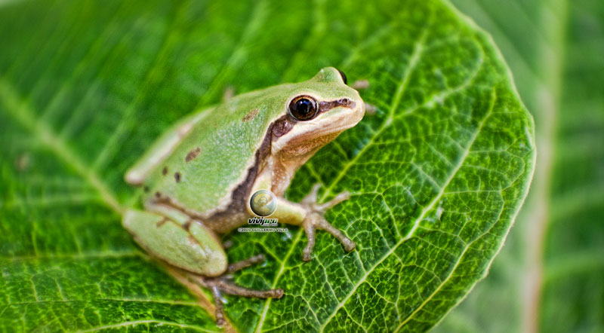
State Amphibian: Arizona Tree Frog

Slide 11
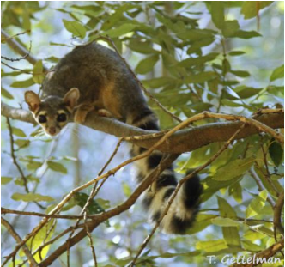
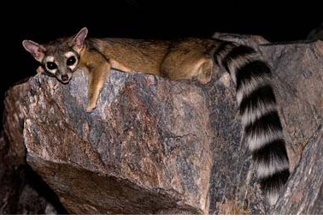
State mammal:Ringtail

Slide 12
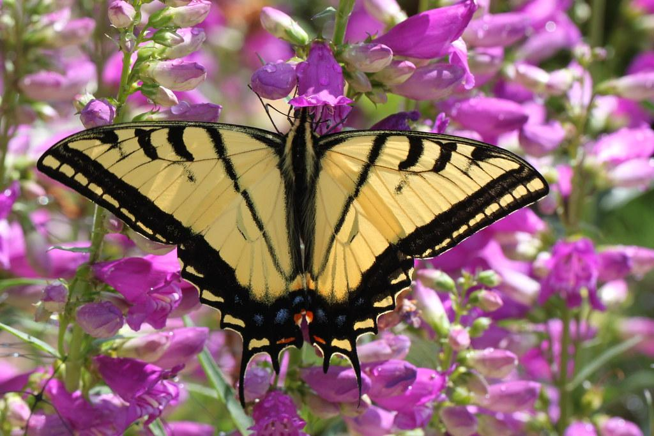
Two-tailed Swallowtail Butterfly
vkmcjc

Slide 13
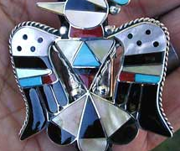
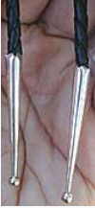
State neckwear- Bola tie

Slide 14
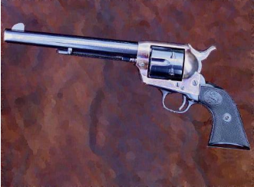
State Firearm- Colt Single Action Army Revolver

Slide 15
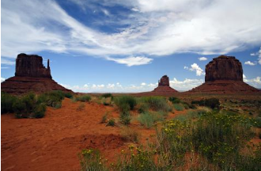
State Motto- Ditat Deus

Slide 16
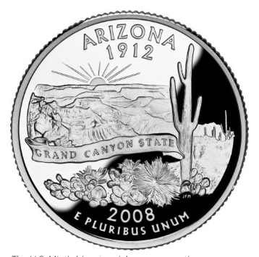
State Nickname- The grand canyon state

Slide 17
#TheEnd!

