Slide 1
Arizona’s Facts
By: Brooklyn Bosman

Slide 2
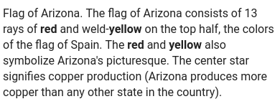
Arizona’s state flag

Slide 3
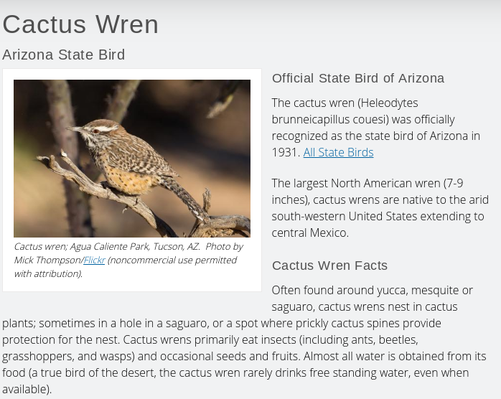
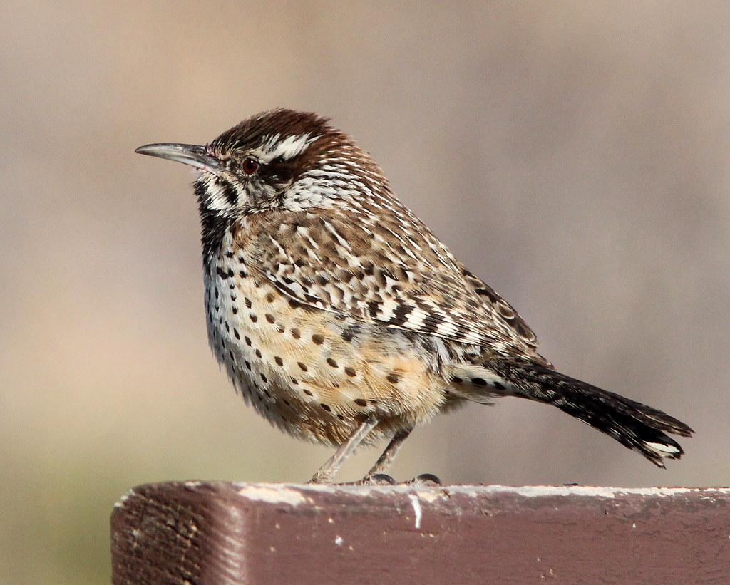
Arizona’s state bird

Slide 4
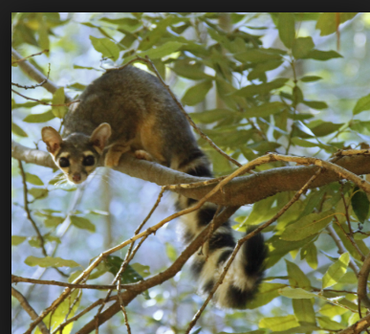
Arizona’s state animal

Slide 5
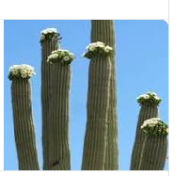
Arizona’s state flower

Slide 6
Arizona’s state motto

Slide 7
The End !!!

